Slide 1
ARRAYS

Slide 2
ARRAY
“An array is a collection of elements of the similar data type”.
In ‘C language’ array is of fixed size. These homogeneous elements could be all integers, or all characters , or all floats etc.
The character array is called a string whereas an integer or float array is called simply an array.
Note that entire elements of any array must be of same data type. i.e. an array of 100 numbers can not have 50 integers and 50 floats.

Slide 3
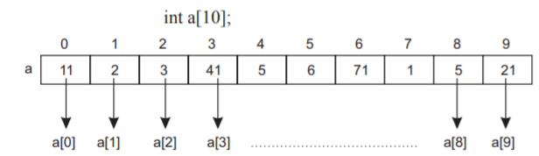
ONE-DIMENSIONAL ARRAY
One-dimensional array has one subscript specification and is declared as follows:
Here “int” is data type of array named “a”. Number given in square brackets ‘[ ]’ denotes the size or length of array “a” i.e. maximum elements that can be stored in the array.
In the above figure variable a[0] has value 11, a[1] has value 2 and so on.

Slide 4
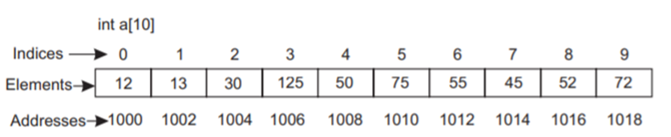
MEMORY ALLOCATION IN ARRAY
There is contiguous memory allocation for different elements of an array.
In the following figure a is an integer array of 10 elements. Assuming integer takes two bytes and the base address of array a is 1000 then address of first element a[0] will be 1000, address of second element a[1] is 1002 and address of third element a[2] is 1004 and so on.

Slide 5
INITIALIZING ONE-DIMENSIONAL ARRAY
One-dimensional array is initialized as follows:
int a[5]= {1,2,3,4,5};
char a[3]={‘a’, ‘b’, ‘c’};
float a[3]={2.1f, 2.2f, 2.3f};
Note: If we initialize only few elements of array then remaining elements assigned with zero value.
Example: int a[5]={1,2,3}
Here a[0] =1, a[1]=2, a[2]=3, a[4]=0 and a[5]=0.

Slide 6
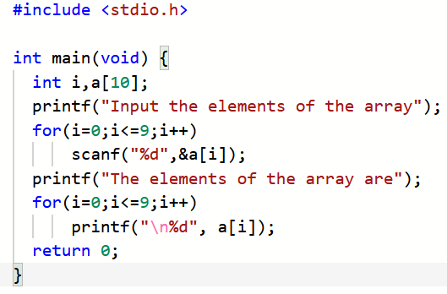
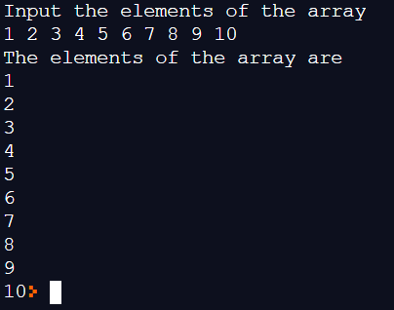
ACCESSING ELEMENTS OF ONE-DIMENSIONAL ARRAY
The following program demonstrates the accessing of elements of an array.

Slide 7
PASSING ARRAYS TO FUNCTION
Like other simple variable, array is also passed to a function.
By default, array is passed using call by reference as its name points to the address of the first element of array.
Individual elements of the array can be passed using call by value.
Example:
void fun(int ar[]); // function declaration
fun(ar); // function calling… passing entire array
void fun(int x); // function declaration
fun(ar[2]); // function calling… passing the value of ar[2]

Slide 8
INSERTING AN ELEMENT INTO ONE-DIMENSIONAL ARRAY
To insert an element in the array at particular position, all the elements from that position must be shifted downward.
Var | Val
a[0] | 2
a[1] | 4
a[2] | 6
a[3] | 8
a[4] | 10
a[5]
…
Var | Val
a[0] | 2
a[1] | 4
a[2]
a[3] | 6
a[4] | 8
a[5] | 10
…
Var | Val
a[0] | 2
a[1] | 4
a[2] | 5
a[3] | 6
a[4] | 8
a[5] | 10
…
Initial array
Elements shifted downwards for pos=3
Final array

Slide 9
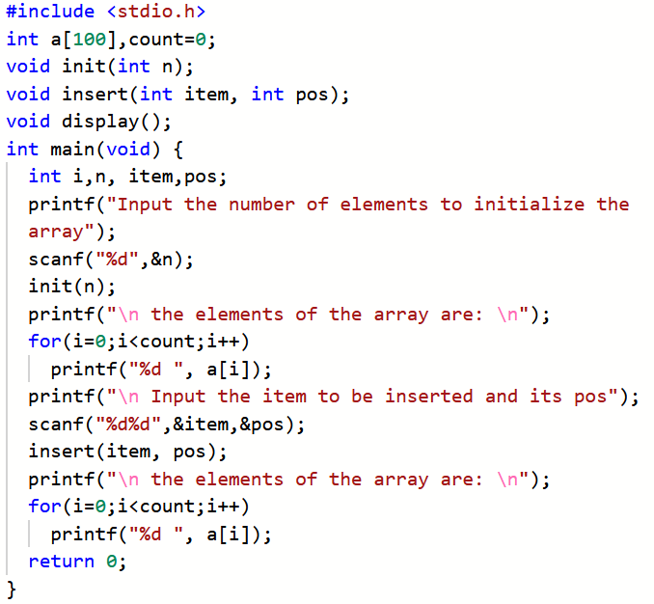
Following program illustrates, how to insert an element in the array at particular position.

Slide 10
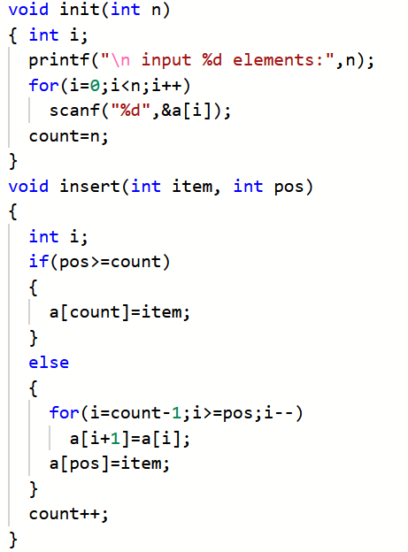

Slide 11
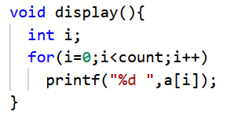
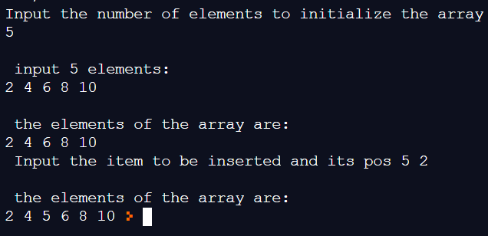

Slide 12
DELETING AN ELEMENT FROM ONE-DIMENSIONAL ARRAY
To delete an element from particular position of the array, all the elements below from that position must be shifted upward to fill the space of deleted element.
Var | Val
a[0] | 2
a[1] | 4
a[2] | 6
a[3] | 8
a[4] | 10
a[5]
…
Var | Val
a[0] | 2
a[1] | 4
a[2]
a[3] | 8
a[4] | 10
a[5]
…
Var | Val
a[0] | 2
a[1] | 4
a[2] | 8
a[3] | 10
a[4]
a[5]
…
Initial array
Elements shifted upwards for pos=3
Final array

Slide 13
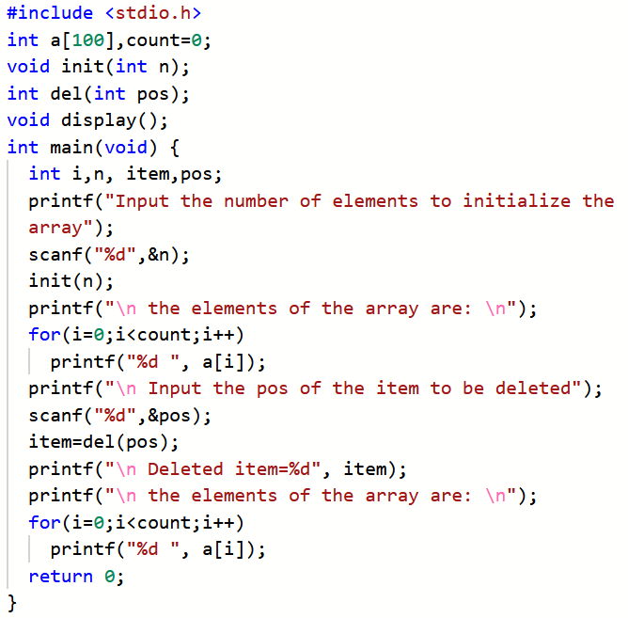
Following program illustrates, how to insert an element from particular position of the array.

Slide 14
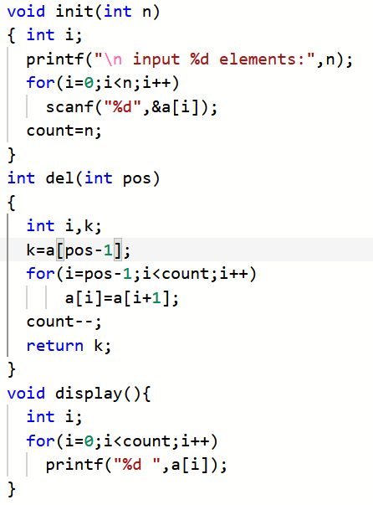

Slide 15
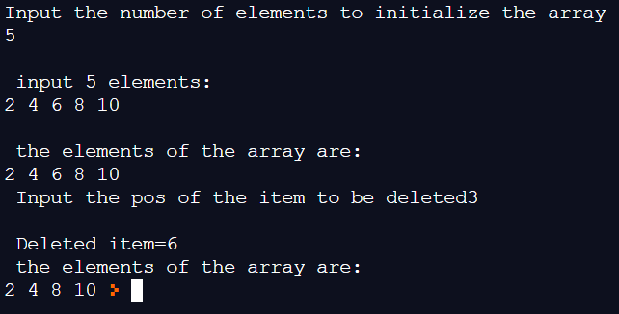

Slide 16
MERGING OF TWO SORTED ARRAY INTO ONE SORTED ARRAY
The following figure shows the merging of sorted arrays and the merged array is sorted.
Var | Val
c[0] | 1
c[1] | 2
c[2] | 3
c[3] | 4
c[4] | 5
c[5] | 6
c[6] | 7
c[7] | 8
c[8] | 10
Var | Val
a[0] | 2
a[1] | 4
a[2] | 6
a[3] | 8
a[4] | 10
Var | Val
a[0] | 1
a[1] | 3
a[2] | 5
a[3] | 7
First sorted array (a)
Second sorted array (b)
Merged Sorted array (c)

Slide 17
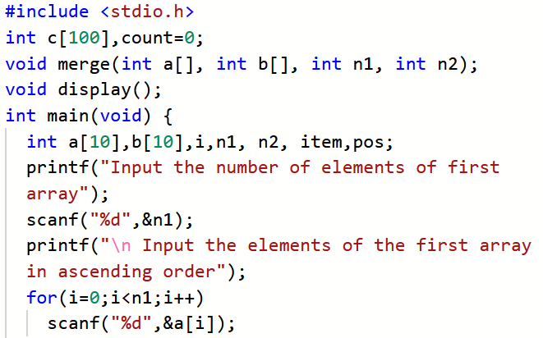
Following program illustrates, how to merge two sorted array.

Slide 18
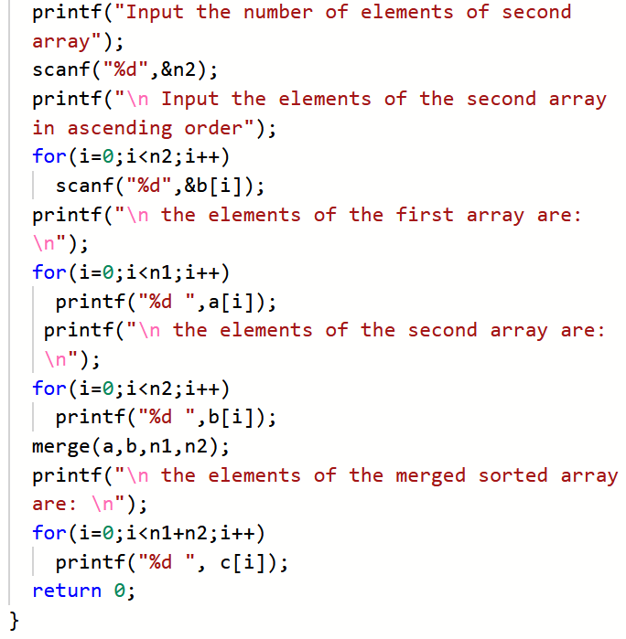

Slide 19
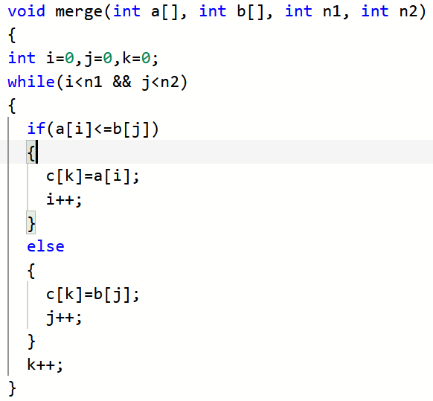
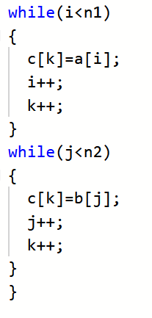

Slide 20
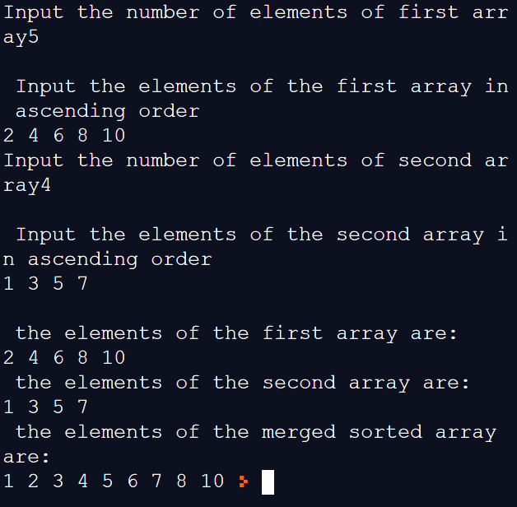

Slide 21
MULTI-DIMENSIONAL ARRAY
Multi-dimensional array is declared as follows:
int a[2][3];
char b[2][2];
Multi-dimensional array is initialized as follows:
int a[3][3]={1,2,3,4,5,6,7,8,9}
int a[3][3]={{1,2,3},{4,5,6},{7,8,9}}

